Slide 1
TORRENT WEB CLIENT PRESENTED BY: GUIDEDE BY: S.JEEVA Mr. K.NARAYANAN M.E.,M.BA, K.TAMILSELVAN ASSISTANT PROFESSOR B.VASANTHAKUMAR
DEPARTMENT OF COMPUTER SCIENCE AND ENGINEERING
INSTITUE OF ROAD AND TRANSPORT TECHNOLOGY

Slide 2
ABSTRACT
The Distributed File system makes download easier and faster by peer-to-peer connection. One among them is Torrent. On observing them keenly, we people come up with an idea of making Torrent Web Client and made Torrent Power web app, which enables users to download torrent files on the easy go.
It is highly platform-independent since it runs on any web browser. Torrent Power also streams your downloading file (video files), so that the user does not need to wait for download completion to watch it.
We made Torrent Power as light as possible, so the user no need to worry about RAM consumption.
We aimed to make “Torrent Power”, the better alternative for any Torrent Downloaders in the market

Slide 3
INTRODUCTION
The term “torrent” refers to file sharing through a decentralized, peer-to-peer (P2P) sharing network.
P2P file sharing allows users to exchange files without uploading these to a server.
Torrenting doesn’t depend on a centralized server for storing files. Instead, bits of data from individual large files are saved in participating computers (peers) in a network (swarm) to facilitate the file-sharing process.
Torrent client (a separate program that reads all the information in the .torrent file and connects users to exchange data).
A torrent file (.torrent) contains information telling users which computers are part of the file-sharing process. It may also provide some details on the files and folders that a user is downloading.

Slide 4
TORRENT TERMINALOGIES
Peers: They are members in peer to peer network (P2P)involved in downloading or uploading of files.
Seeders: They are the ones seeding files and allowing users to take bits of their data that has been fully downloaded on their computers.
Leechers: They are the people who are downloading the file in bits from the seeders.
Indexers:The websites which work as a search engine for the files and content to be downloaded through a torrent are known as indexers. ( Torrentz, RarBG , Piratebay )
Trackers: Act as bridges in a P2P network transferring small data pieces between uploaders and downloaders.
Clients: Are applications that act as requirements for downloading the torrent files. (BitTorrent, UTorrent)

Slide 5
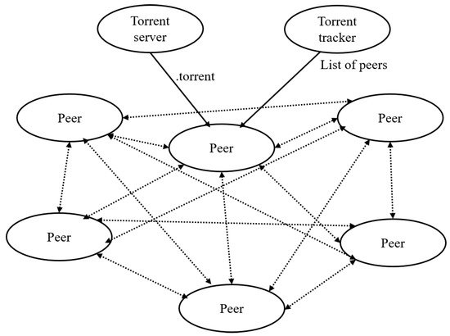
Peer-To-Peer system

Slide 6
SYSTEM SPECIFFCATION
HARDWARE SPECIFICATION
Processor : Intel Pentium 4
RAM : 2.00GB
System Type : 32 OR 64 bit
Speed : 10 Mbps
SOFTWARE SPEIFICATION
Operating System : Any (Microsoft Windows, LINUX , MacOS)
Web Browser :Any (Chrome, Firefox, Edge )
Tool : Visual Studio Code
Language : JavaScript

Slide 7
TECHNOLOGIES USED FOR DEVELOPMENT
Programming Language : JavaScript
Backend File Serving : NodeJS
Front End UI : HTML, CSS , React JS
Front End Design Icons : Material UI
Data Base : Mongo DB
Torrent Service : Web Torrent

Slide 8
Start
Torrent file/magnetic link
Tracker
Peer-to-peer (seeding peers)
Starts downloading/ Streaming
i.e leeching
Download Complete
seeding
End

Slide 9
MODULES
Login Page: Sign In / Sigh Up of user
Navigation Panel: Redirection between different pages
Home Page: Dowloading through Magnetic Links
Downloads Page Past Dowloads are grouped together
Favorites Page: Favorite items are grouped togther
Profile Page: Profile Management and user details
Settings Page: Customizable settings for application
Magnetic Links Page: Sources to get magnetic links

Slide 10
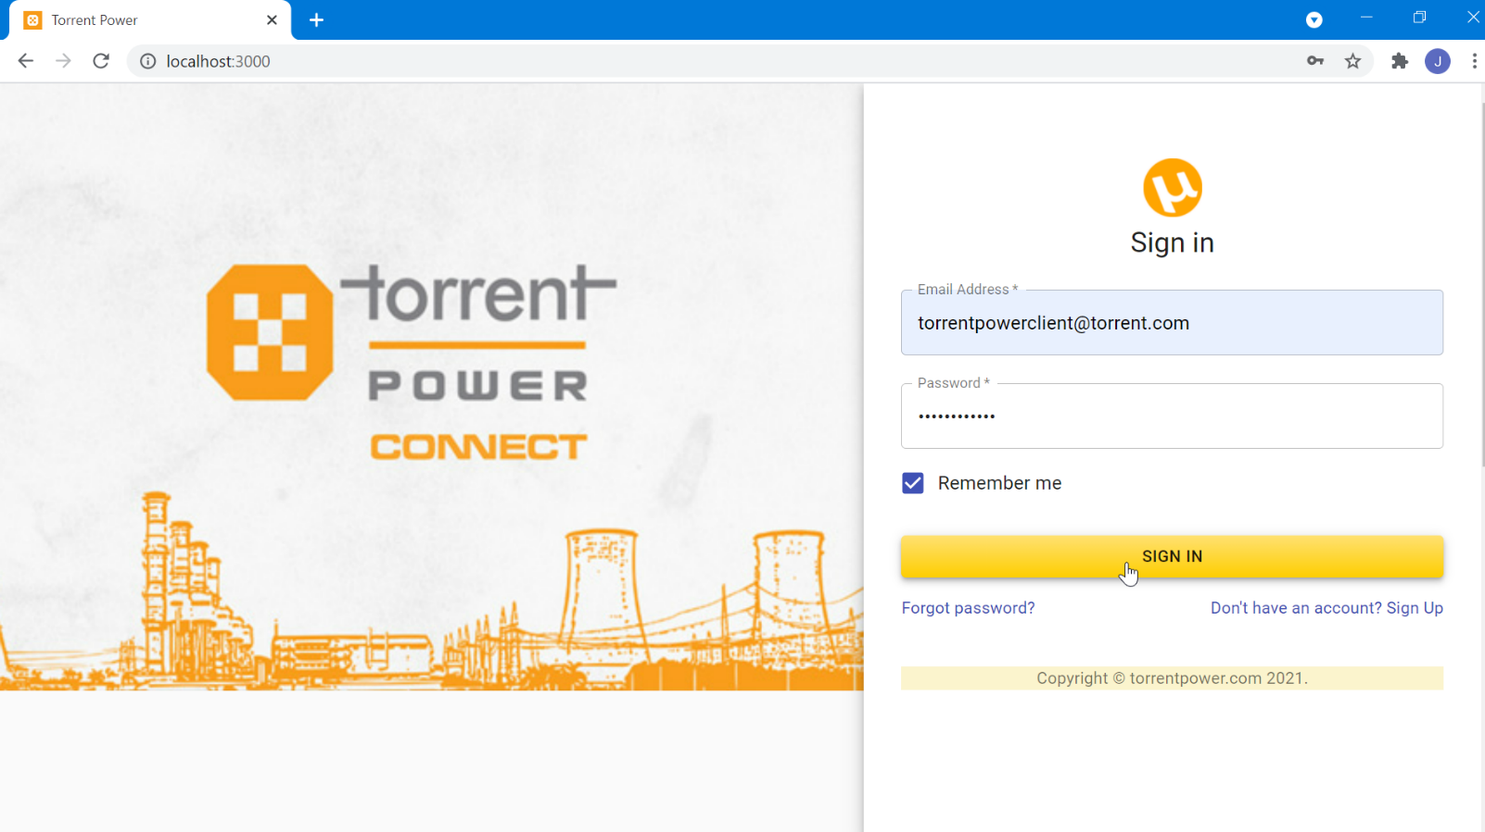
Login Page:

Slide 11
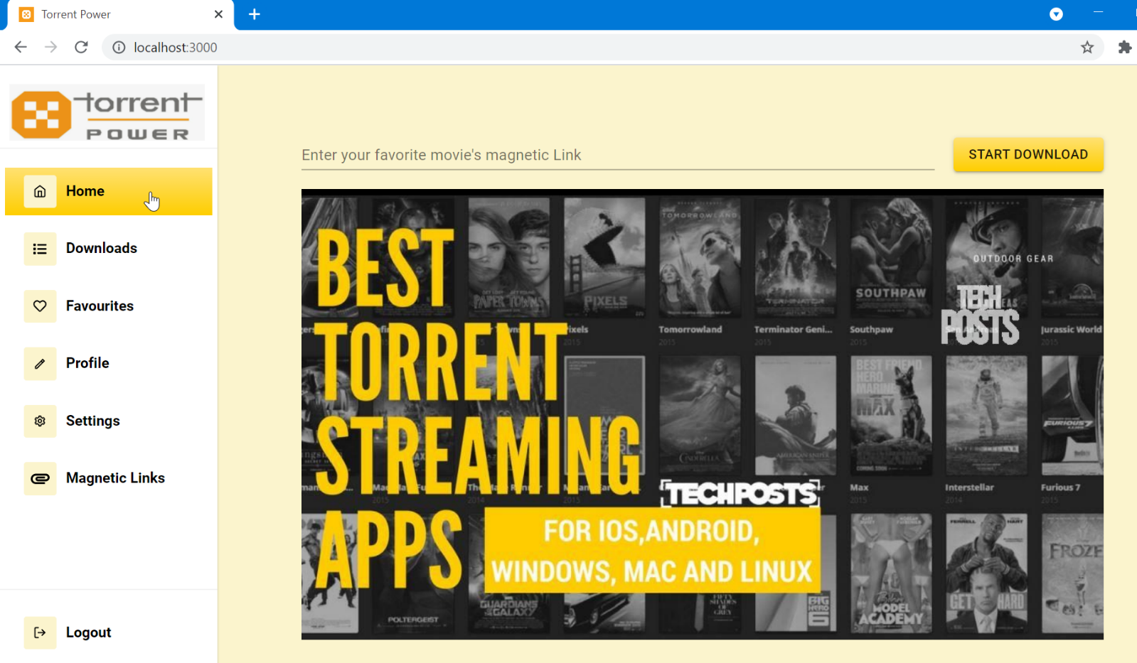
Home Page:

Slide 12
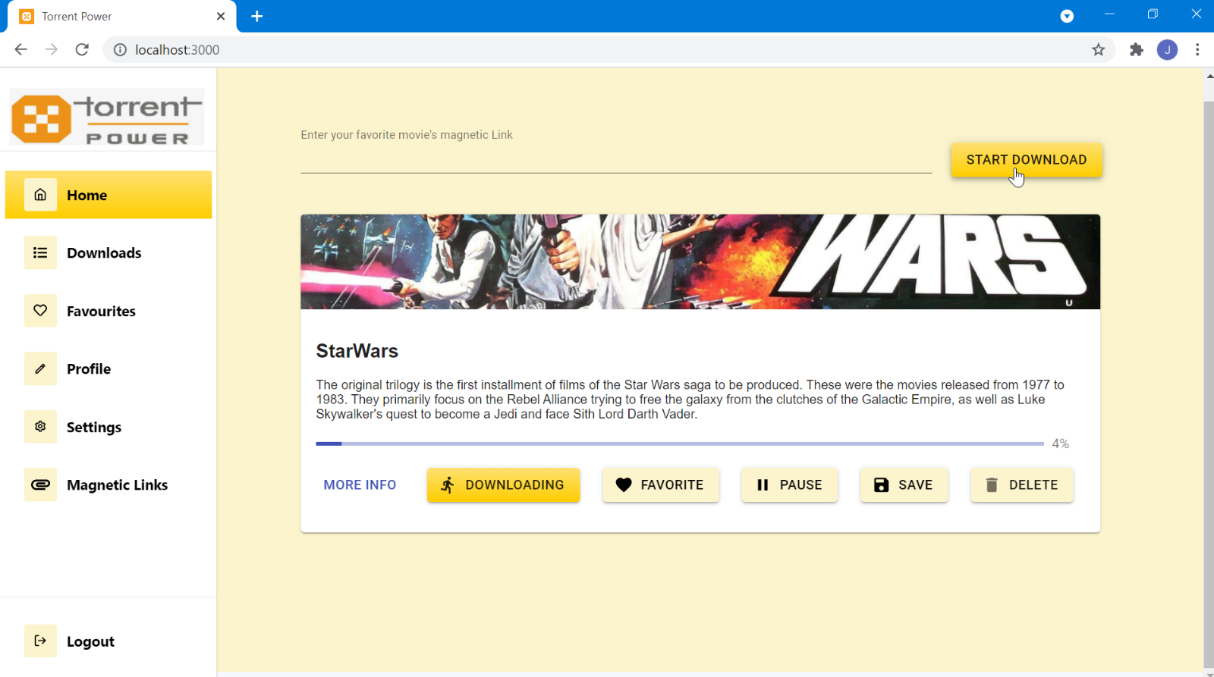

Slide 13
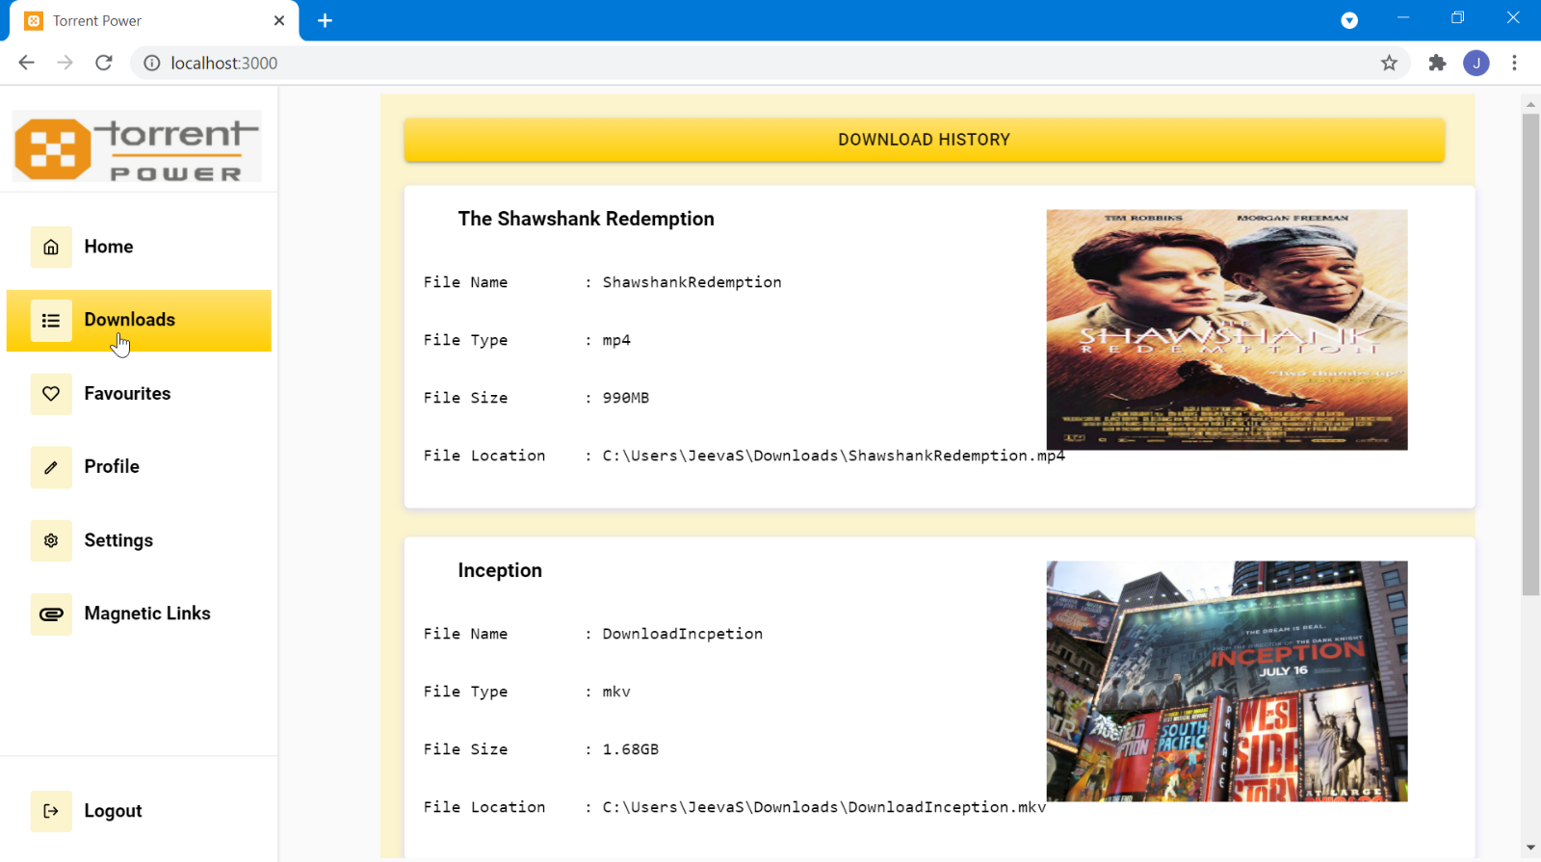
Downloads Page:

Slide 14
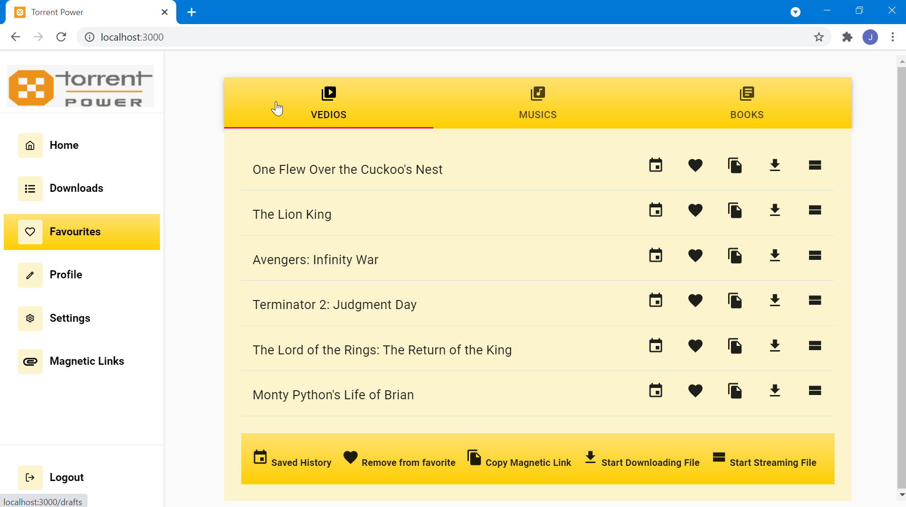
Favorites :

Slide 15
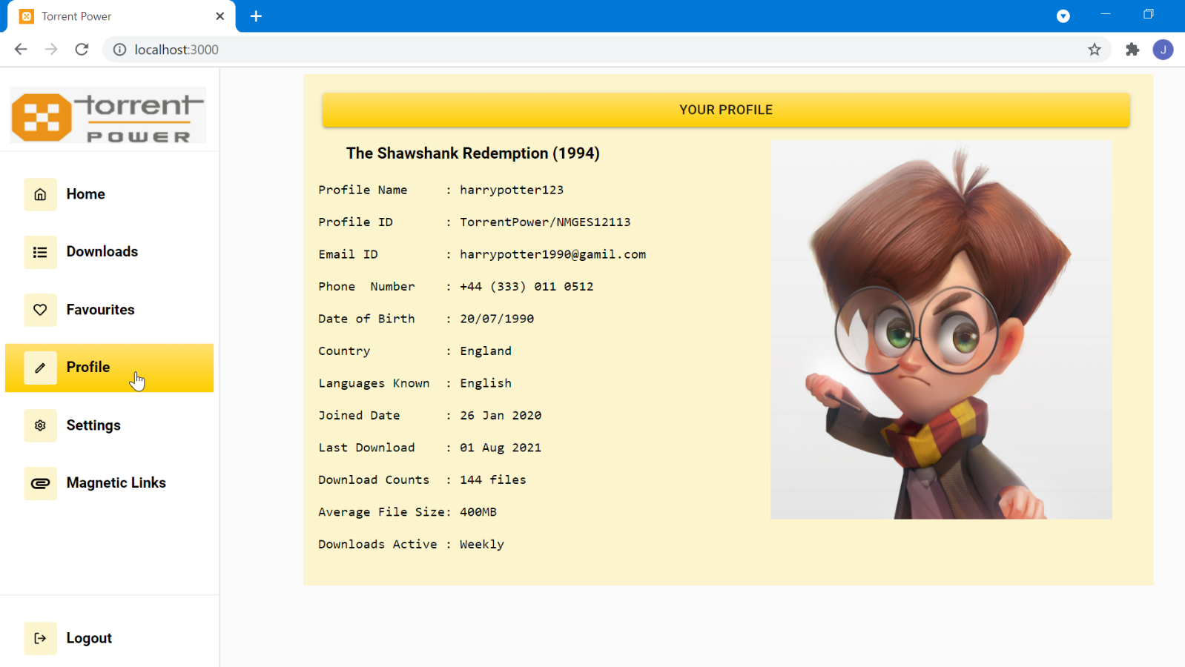
Profile Page :

Slide 16
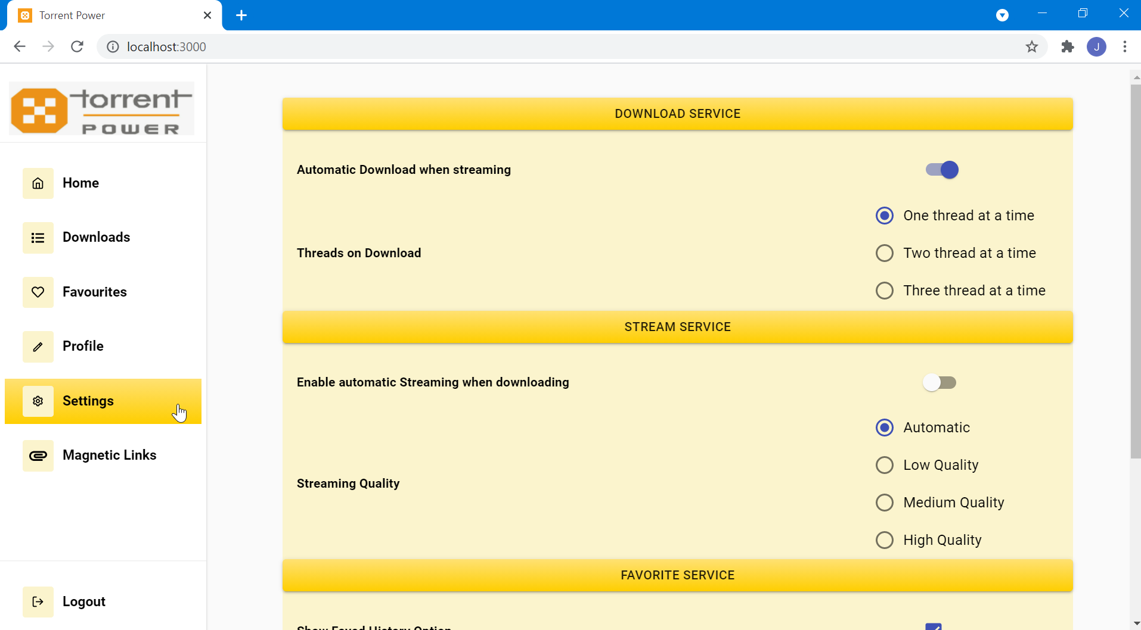
Settings Page:

Slide 17
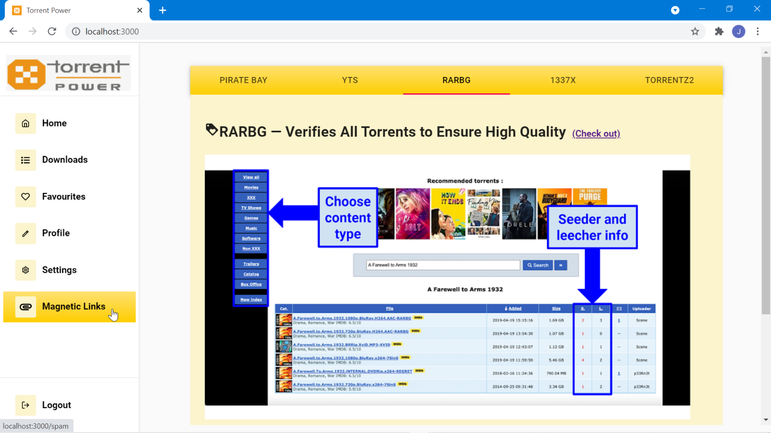
Magnetic Links :

Slide 18
CONCLUSION
In this paper, downloading torrent file is performed. Using this web app we can download and see streaming of the videos. This project is helps the user to download and streaming through web application “Torrent Power” which is lightweight one and doesn’t need any extra setup to use it. Thus it became the best alternative for all other torrent platforms avail in market.

Slide 19
FUTURE ENHANCEMENT
Have to enable encryption file sharing options with the inclusion of authentication, so that private files can also be shared by Torrent .
Have to improve the responsiveness to all devices, so the user experience will be improved in his device of choice.
Have to make the software as lighter as possible, so that user can use it with low RAM consumption which gives him smooth experience.
Have to make the whole web application into progressive web application (PWA) , so that user can use the software without internet connections.

Slide 20
REFERENCES
Web Torrent: A Streaming Torrent Client:
https://github.com/webtorrent
How to make your own BitTorrent client :
https://allenkim67.github.io/programming/2016/05/04/how-to-make-your-own-bittorrent-client.html
Peer-to-peer networking with BitTorrent :
http://web.cs.ucla.edu/classes/cs217/05BitTorrent.pdf
Bio Torrents: A File Sharing Service for Scientific Data :
https://journals.plos.org/plosone/article?id=10.1371/journal.pone.0010071

